Slide 1
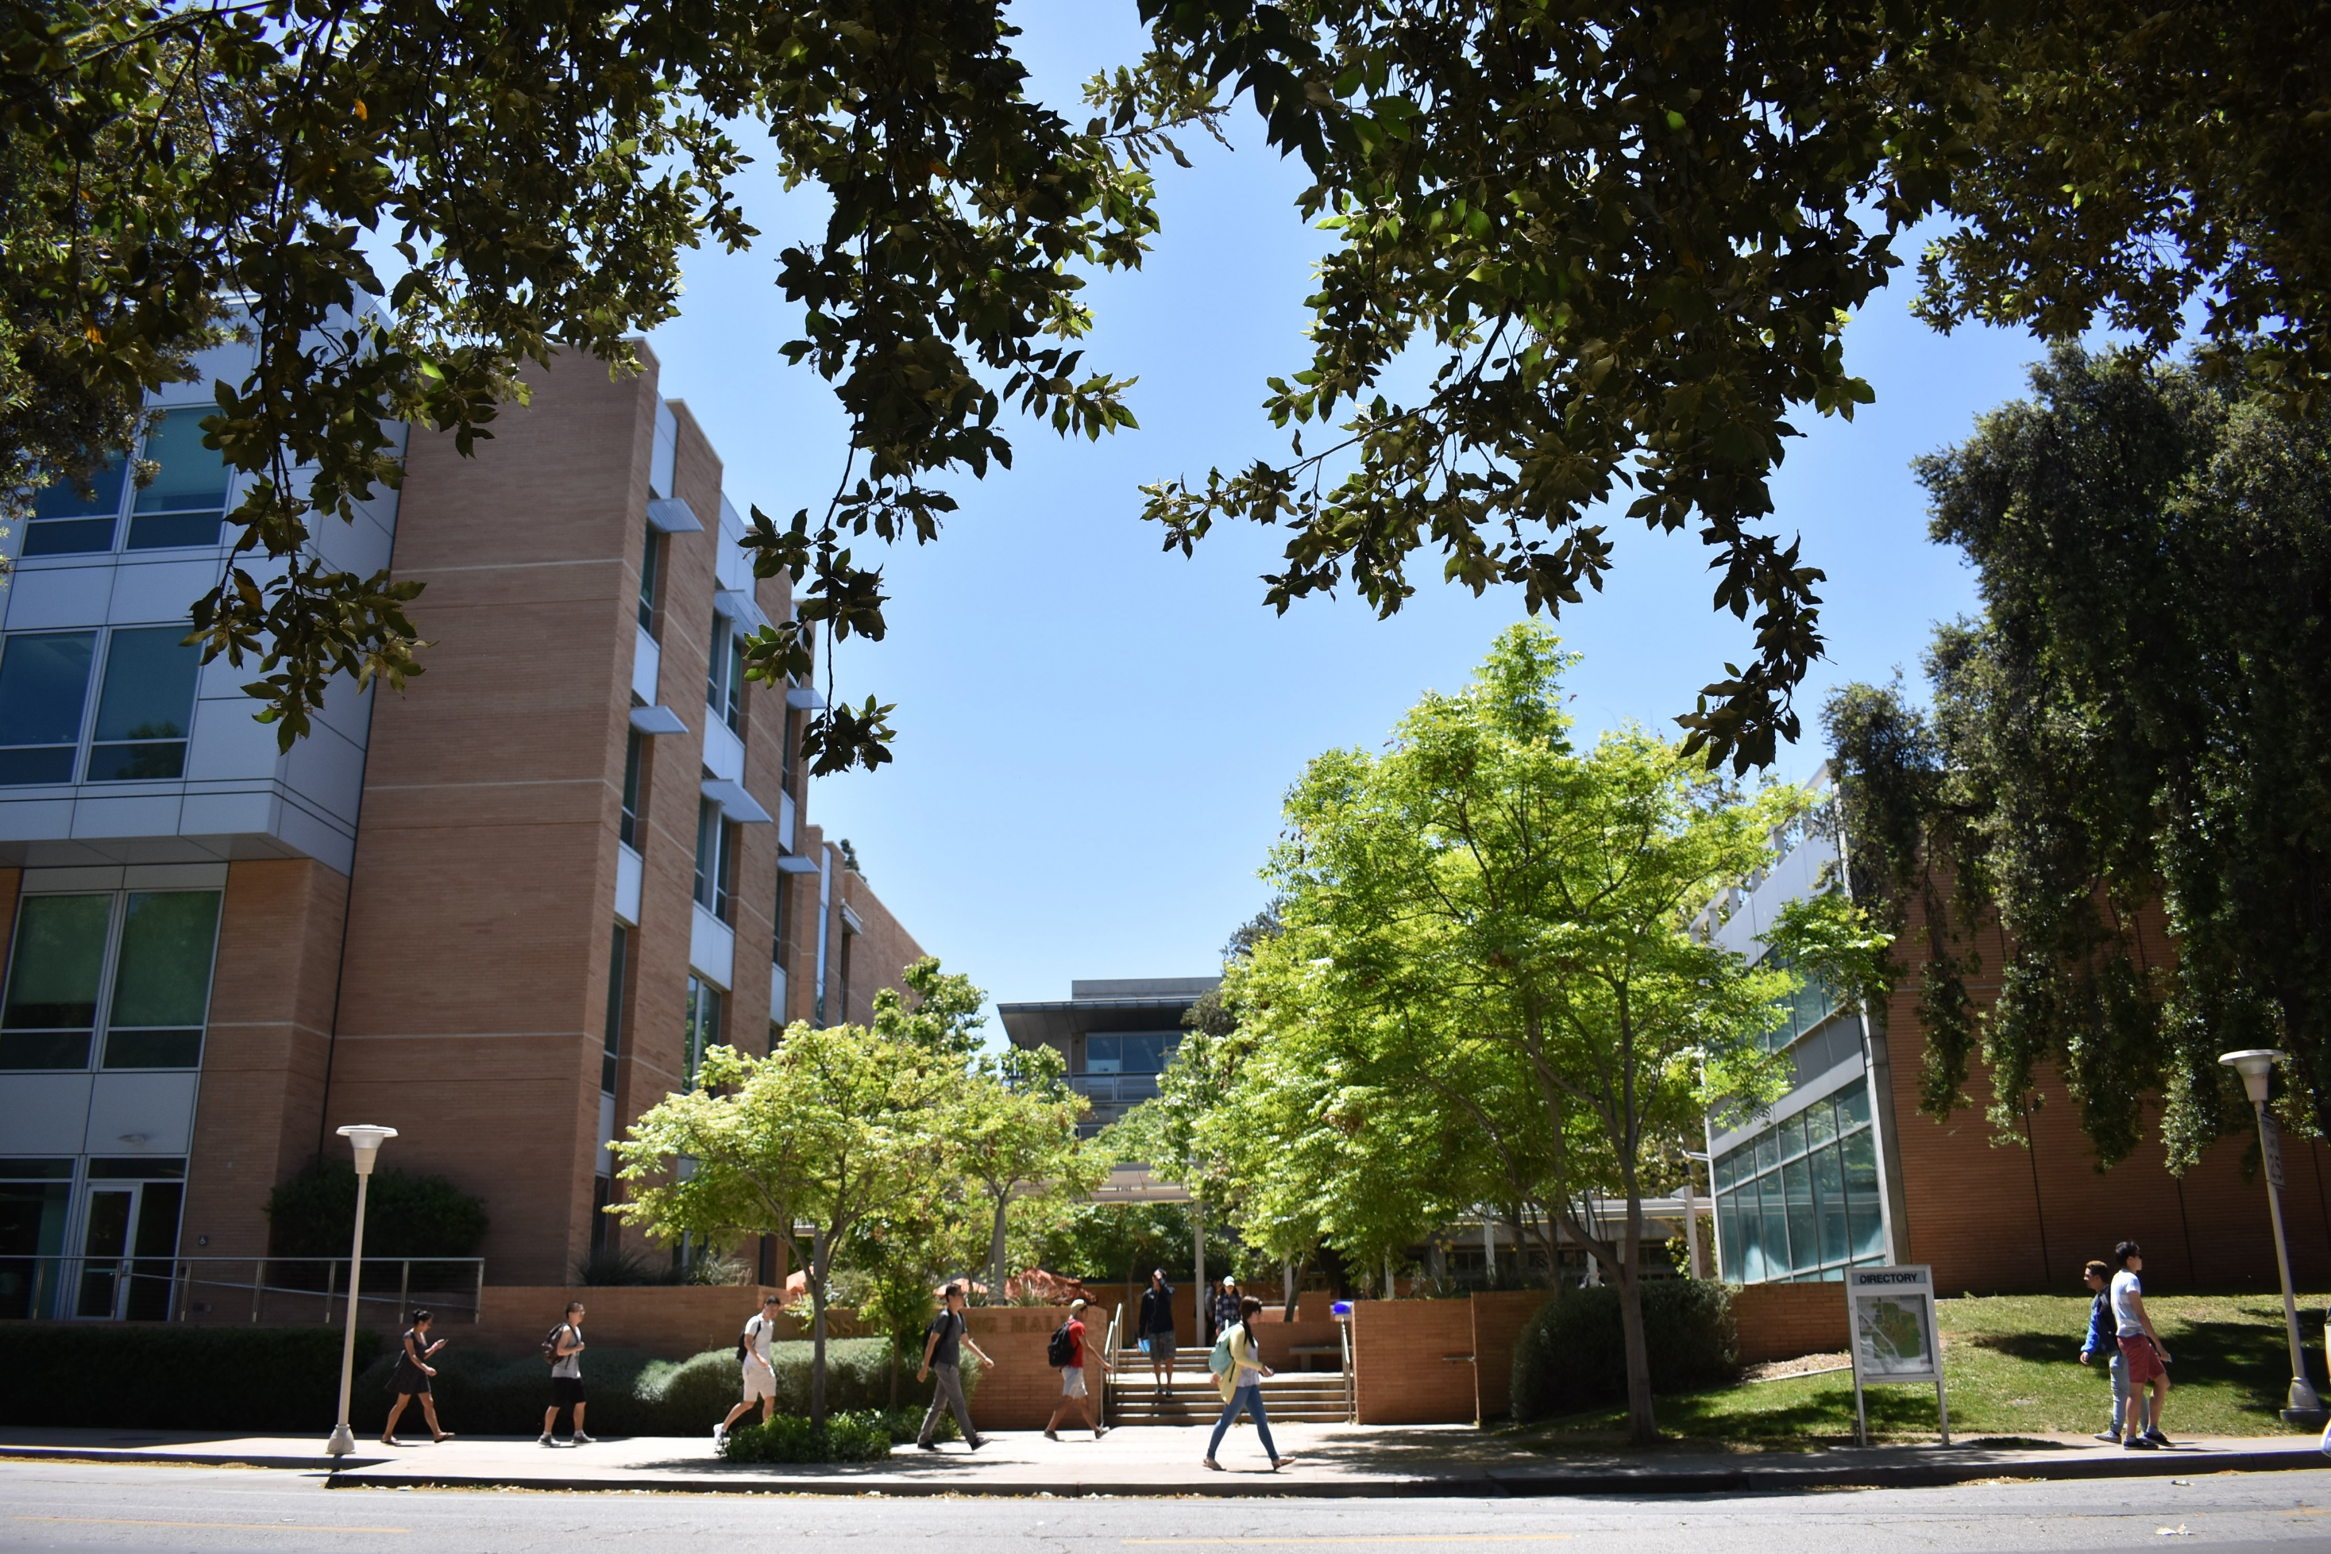


Slide 2

COLLEGE RANKING
No. 33
Among public engineering colleges
10-Rank Jump
Top 5
2017
No. 71
2018
No. 67
2019
No. 61
Hispanic-serving public engineering colleges in the U.S.
Notes:
BCOE rankings also saw a jump in rankings the last few years. We are now No. 61 in the nation, No. 33 among public universities, and among the top five Hispanic-serving public engineering colleges in the U.S.

Slide 3

LEADERS IN PUBLIC ENGINEERING EDUCATION
Chemical Engineering
Computer Engineering
Electrical Engineering
Bioengineering
No. 41
No. 29
No. 31
No. 35
Best Engineering Schools in U.S.
Materials Science & Engineering
Mechanical Engineering
Master of Science in Engineering Online
Environmental Engineering
No. 33
No. 29
No. 44
No. 43
No. 38
Notes:
Taking a closer look at where our department’s stand with rankings, all of our programs are ranked in the top 50 among other public engineering colleges.

Slide 4
RESEARCH CENTERS
Center for Environmental Research and Technology
(CE-CERT)
Winston Chung Global Energy Center
(WCGEC)
Center for Nanoscale Science and Engineering
(CNSE)
Center for Advanced Neuroimaging
(UCR CAN)
Center for Research and Education in Cyber Security and Privacy
(CRESP)
Center for Industrial Biotechnology
(CIB)
UCR-KIMS Center for Innovative Materials for Energy and Environment
(CIME)
Center for Ubiquitous Communication by Light
(UC-LIGHT)
Center for Research and Intelligent Systems
(CRIS)

Slide 5
COLLEGE GROWTH
5-year growth:
34% increase
DISTINGUISHED FACULTY
97 Fellows of professional societies
57 CAREER and junior faculty awards
NEW! Member of the National Academy of Engineering in Mexico
Notes:
This chart demonstrates consistent growth for our faculty base, which contributes to the ranking increases.

Slide 6
GRANT OVERVIEW
$50M
$39.4M
$38M
IN MILLIONS
$29.4M

Slide 7
GRANT OVERVIEW
Fiscal year numbers taken from July
Notes:
Digging deeper on average grant amount awarded.
In 2010, BCOE: $31,831,017/197 awards ($162K)
In 2011, BCOE: $24,027,588/182 awards ($132K)
In 2012, BCOE: $28,379,858/204 awards ($139K)
In 2013, BCOE: $20,637,460/158 awards ($131K)
In 2014, BCOE: $28,456,501/203 awards ($140K)
In 2015, BCOE: $29,438,963/201 awards ($147K)
In 2016, BCOE: $39,446,484/234 awards ($169K)

Slide 8
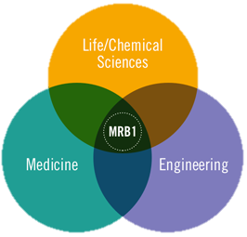
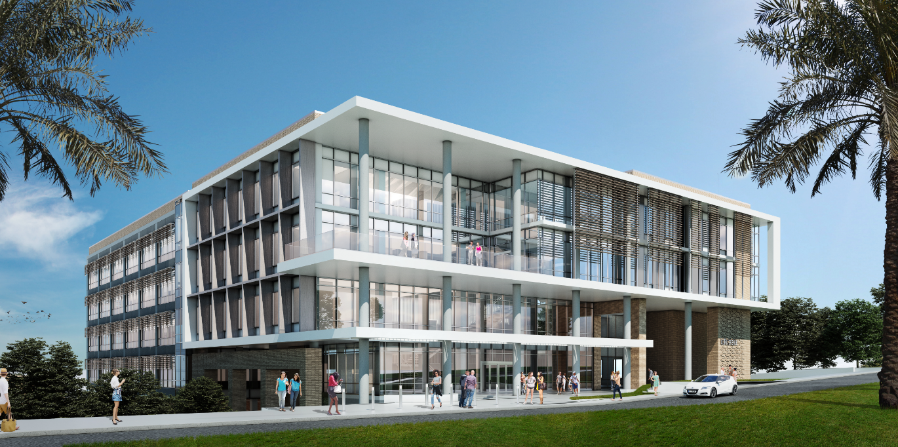
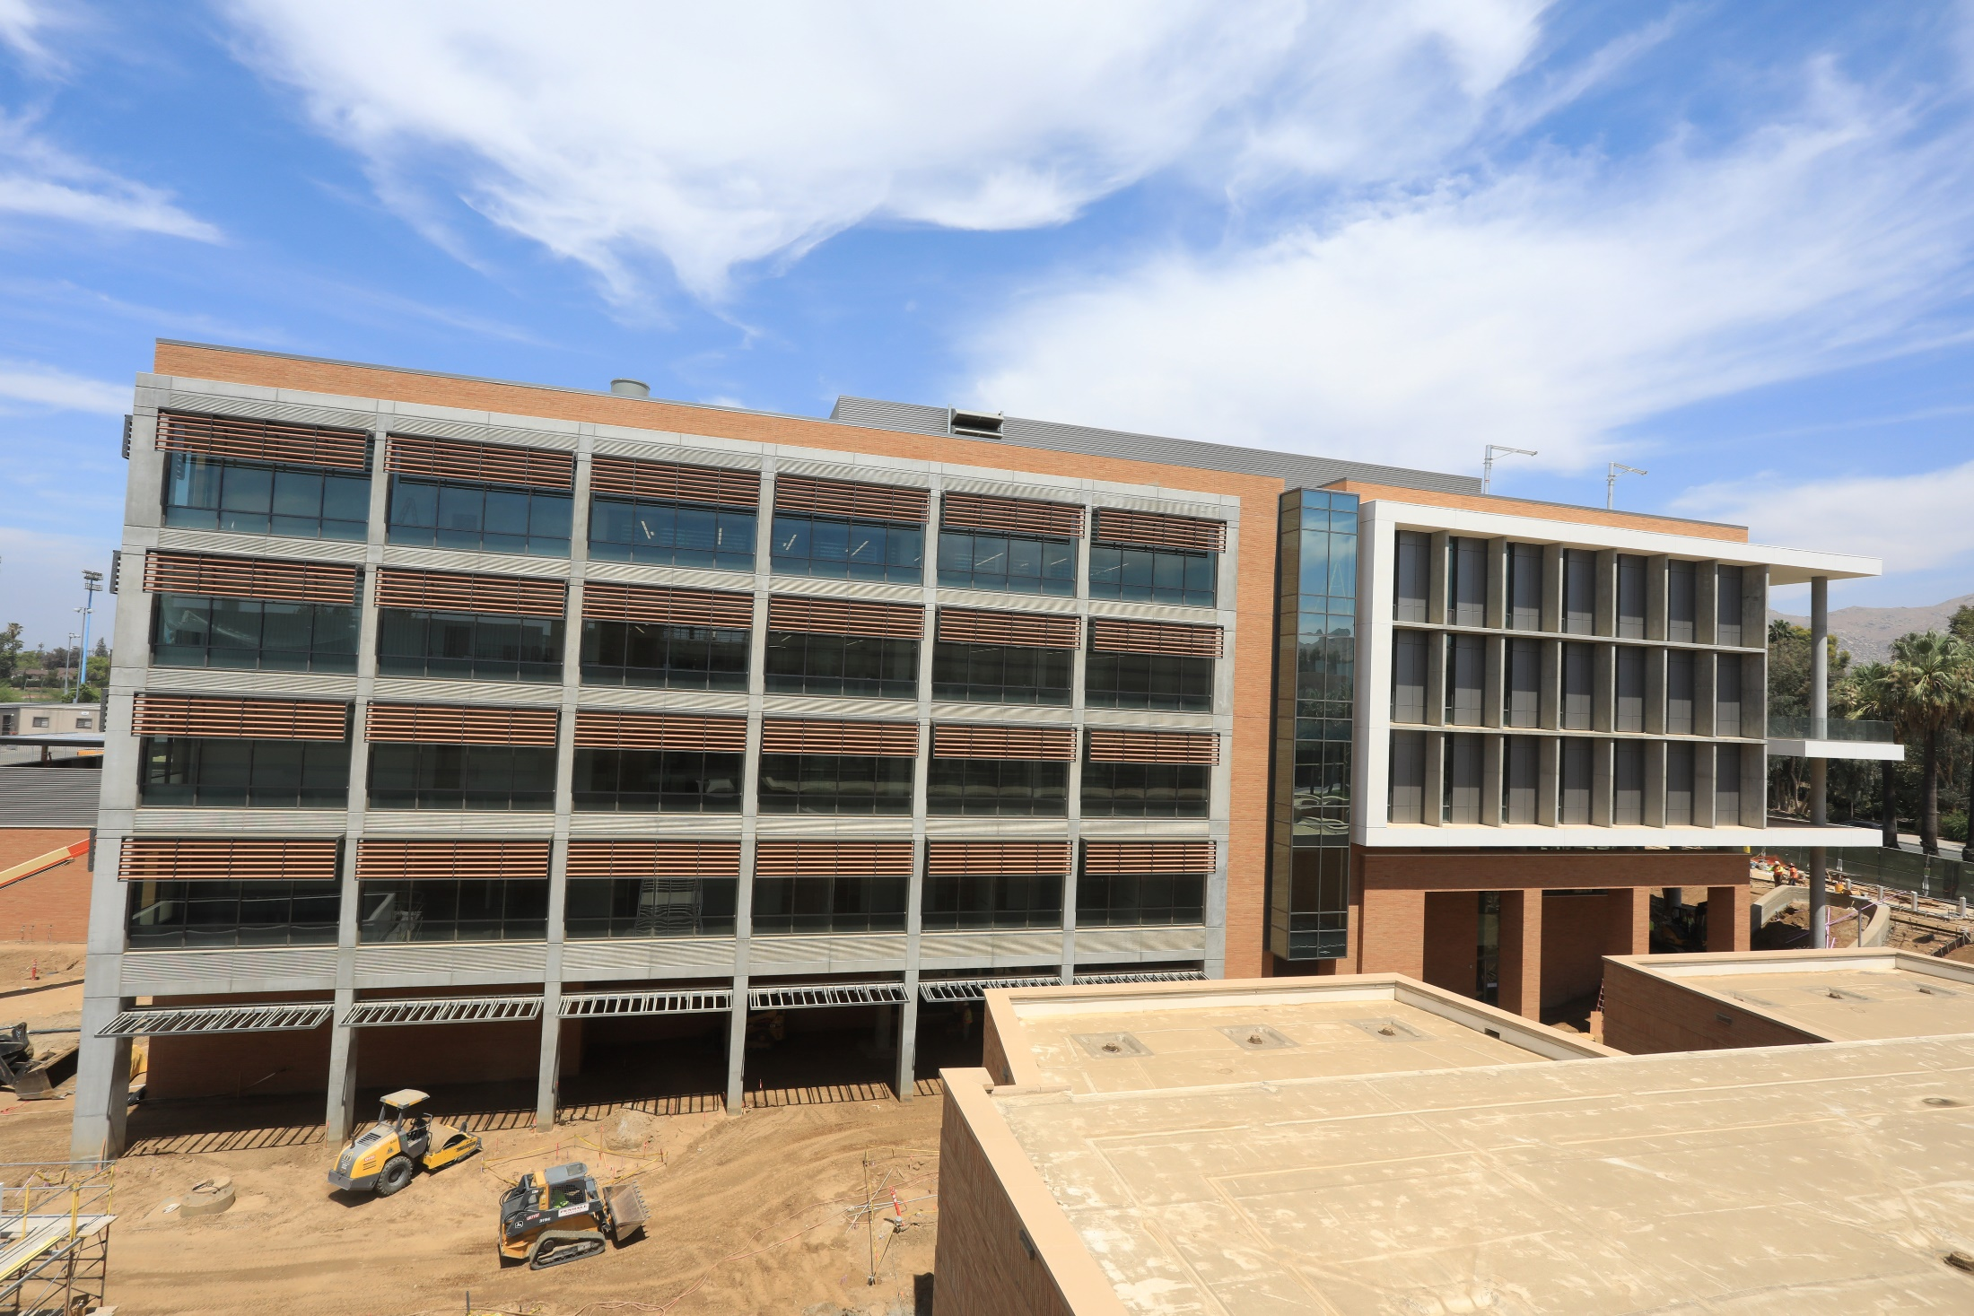
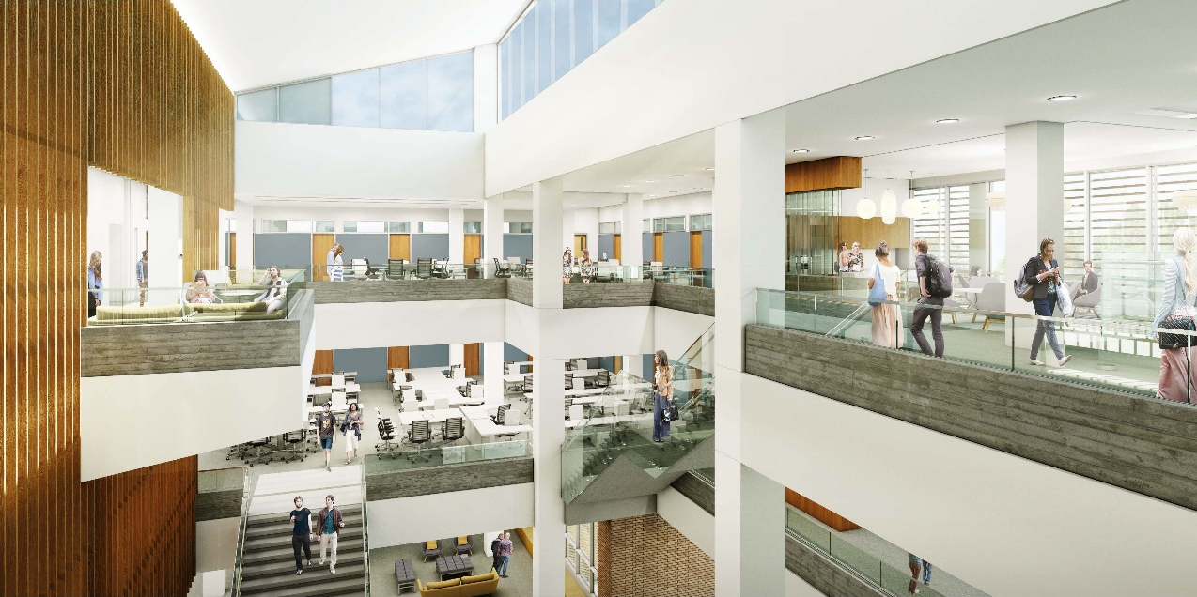
MULTIDISCIPLINARY RESEARCH BUILDING
BCOE
AS OF AUGUST 2018
Notes:
Our research facilities are expanding next year with the addition of MRB. The five-story, 180,000 square feet building holds 56 PIs and their teams. Six of the eight teams who will be among the first wave of building occupants include engineering faculty.

Slide 9
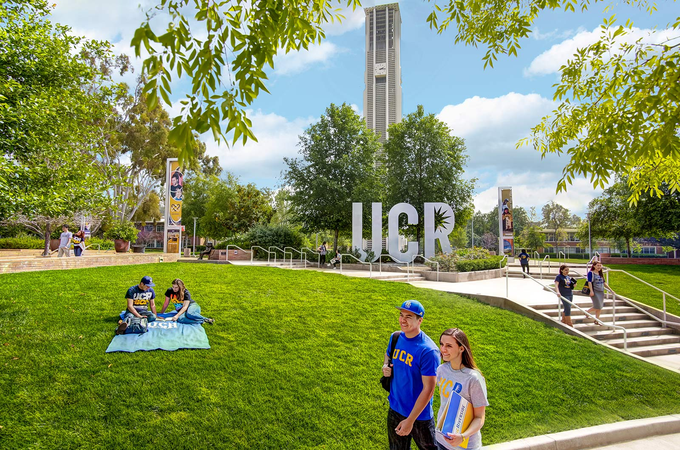
THANK YOU

