Slide 1
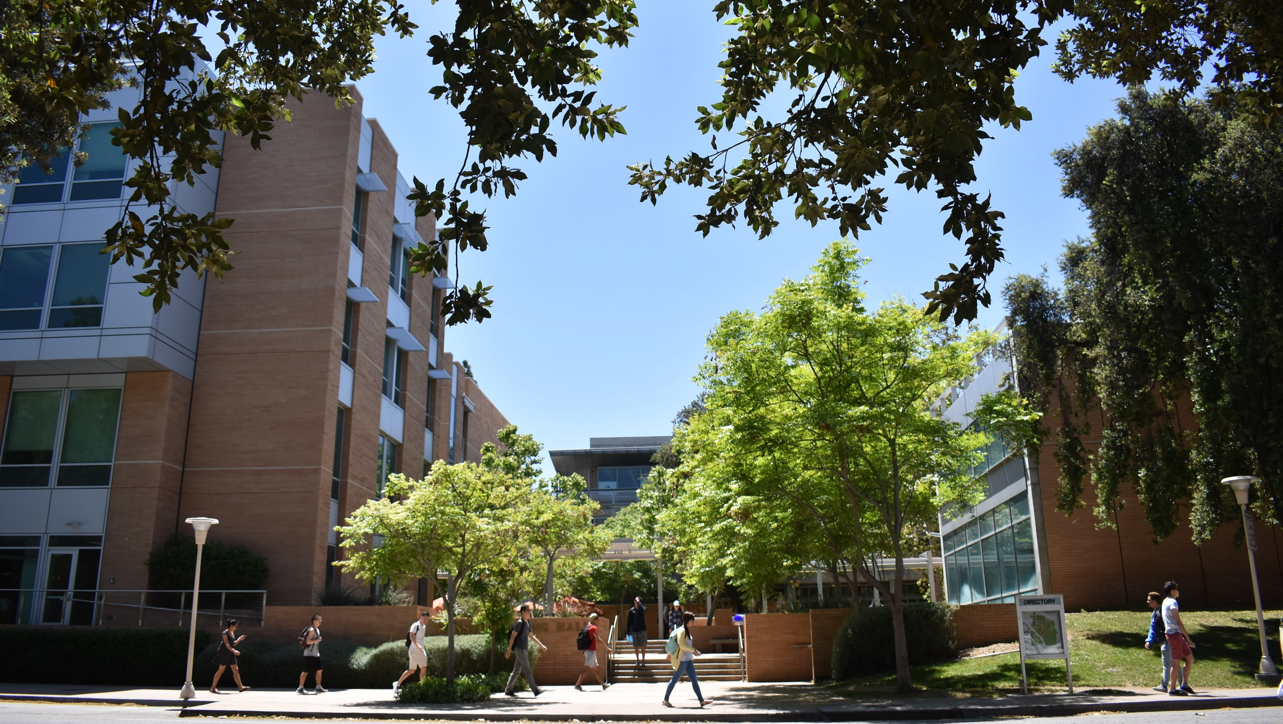

NEW FACULTY ORIENTATION
Jay Farrell
Associate Dean, Academic Personnel

Slide 2
NEW FACULTY INTRODUCTIONS
Asst. Professor, BIEN
Christopoulos Vasileios
Assoc. Professor, CEE
Younjin Min
Asst. Professor, CEE
Yujie Men
Asst. Professor, CEE
Yun Shen
Asst. Professor, CSE
Hung-Wei Tseng
Asst. Professor, CSE
Amey Bhangale
Asst. Professor, CSE
Yan Gu
Asst. Professor, CSE
Yihan Sun
Assoc. Prof. of Teaching, ECE
Roman Chomko
Asst. Professor, ECE
Xi Chen
Asst. Professor, ME
Erfan Nozari
Asst. Professor, ME
Jun Sheng

Slide 3
NEW FACULTY ORIENTATION AGENDA
Open Access Policy & Data Management
Computing & Technical Support
Contracts & Grants
Finance/Personnel
Marketing/Websites/Communications
Academic Personnel
Facilities & Safety
Graduate Education
Undergraduate Education/Student Organizations & Professional Development Program
Undergraduate Course Scheduling/Advising
Transition to Panelist Session
Goal: To meet colleagues who can facilitate your success
11 speakers in 2 hours
5 minute presentations; 3 minutes of questions
Presentations focus on:
How their group can help you succeed
Who is in their group and what each person does
Tidbits of advice as appropriate
Slides to be posted on faculty resources web page

Slide 4
BCOE Departments and Programs
Departments:
Bioengineering
Chemical & Environmental Engineering
Computer Science & Engineering
Electrical & Computer Engineering
Mechanical Engineering
Programs:
Bioengineering (BS, MS, PHD)
Chemical Engineering (BS, MS, PHD)
Computer Engineering (BS, MS)
Computer Science (BS, MS, PHD)
Computer Science with Business Applications (BS)
Electrical Engineering (BS, MS, PHD)
Environmental Engineering (BS, MS, PHD)
Materials Science and Engineering (BS, MS, PHD)
Mechanical Engineering (BS, MS, PHD)
BS Programs ABET Accredited through September 30, 2025
Comprehensive general review: 2024

Slide 5
RESEARCH CENTERS
Center for Environmental Research and Technology
(CE-CERT)
Winston Chung Global Energy Center
(WCGEC)
Center for Nanoscale Science and Engineering
(CNSE)
Center for Advanced Neuroimaging
(UCR CAN)
Center for Research and Education in Cyber Security and Privacy
(CRESP)
Center for Industrial Biotechnology
(CIB)
UCR-KIMS Center for Innovative Materials for Energy and Environment
(CIME)
Center for Ubiquitous Communication by Light
(UC-LIGHT)
Center for Robotics and Intelligent Systems
(CRIS)

Slide 6
COLLEGE GROWTH
DISTINGUISHED FACULTY
100 Fellows of professional societies
57 CAREER and junior faculty awards
2 PECASE Award recipients
NEW! Member of the NAE in Mexico

Slide 7
RESEARCH GRANTS AWARDED
Funding & review delays due to govt. shutdown
MAJOR AWARDS
$4.5M GAANN Awards
CEE, CSE, ECE, ME
$50M
$1.5M AFOSR
PI: Fabio Pasqualetti
$39M
$38M
$38M
$1.4M NSF
PI: Vagelis Christidis
Ahmed Eldawy, Vassilis Tsotras
IN MILLIONS
$29M
$1.2M NSF
PI: Albert Wang
Ramdas Pai, Gang Chen
$1.2M ONR
PI: Amit Roy-Chowdhury
Konstantinos Karydis, Salman Asif, Fabio Pasqualetti

Slide 8







RANKINGS
Additional UCR Rankings
Top 50
U.S. News & World Report Public Engineering Colleges
Top 30 in salary potential
PayScale, Best Schools for Engineering Majors by Salary Potential
No. 1 in social mobility
- U.S. News & World Report Best College rankings
No. 1 most transformative university
- Money Magazine
No. 12 public university
- Forbes “America’s Best Value Colleges”
No. 16 public university, No. 27 overall
- Washington Monthly
Top 10 colleges that pay the most in big cities
- CNBC

Slide 9
STRATEGIC PLANNING
Department chairs
Center directors
Broad input received from faculty
Another round of faculty input coming soon
Academic Research
Student Growth
Faculty Growth
Strategic Planning Process
Strategic Plan Development
Operational Plan Development
Physical Resources
Outreach/ Recruitment
Culture/ Experience
Marketing Outreach
Budget & Resource Needs
Philanthropy
11 subcommittees
90+ faculty/staff participants
Timeline:
Unveiling October 2019
Feedback November 2019
Revision December 2019
Implementation January 2020
Notes:
Focus on high participation by faculty and staff and that a round of input will be coming later in the summer.

Slide 10

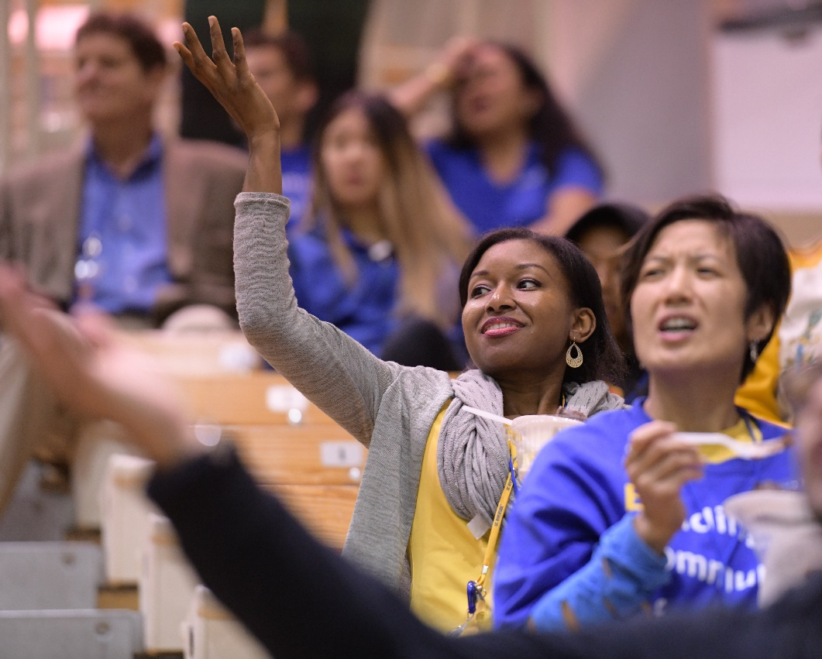
MARK YOUR CALENDAR
ENGINEERING NIGHT
UCR VS. REDLANDS BASKETBALL GAME
NOVEMBER 21, 2019
Time TBD
RSVP: LINK COMING SOON!
Free registration includes:
Game ticket, parking, and reception entrance
Families are welcome!

