Slide 1
… And Knowing is Half the Battle: Some Pragmatic Strategies for Obtaining DoD Research Funding
Suveen N. Mathaudhu^{1,2}
¹UCR Mechanical Engineering and Materials Science and Engineering Program
²Former Government Lackey

Slide 2


Slide 3


Slide 4
Unlike NSF, the DoD in not interested in funding research simply for the sake of advancing science

Slide 5
The DoD has specific needs and challenges arising from their defense mission

Slide 6
You need to understand those needs as thoroughly as possible to maximize your chances of support

Slide 7
Who are the Agencies?
Air Force Office of Sponsored Research
Office of Naval Research
Army Research Office
Defense Advanced Research Projects Agency
Defense Threat Reduction Agency
Office of the Secretary of Defense

Slide 8
The “Color” of DoD $$$
6.1 Basic Research: usually university research funding
6.2 Applied Research: may be a continuation of 6.1 as it becomes closer to application; normally funded university + industry/lab
6.3 Application Research: where a new technology is applied to a defense system and tested; normally done in industry/defense contractor

Slide 9
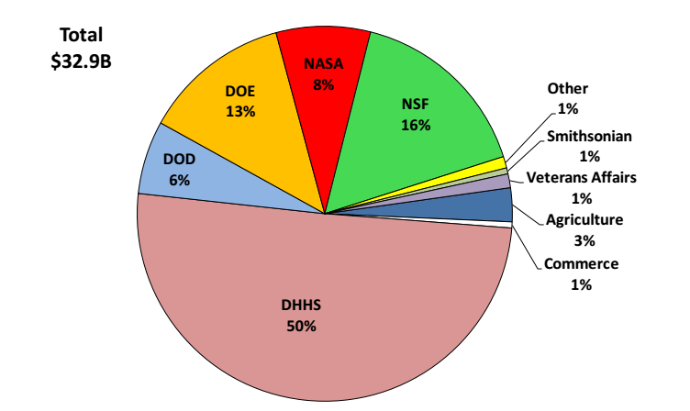
6% of Federal Agency Basic Research Support

Slide 10
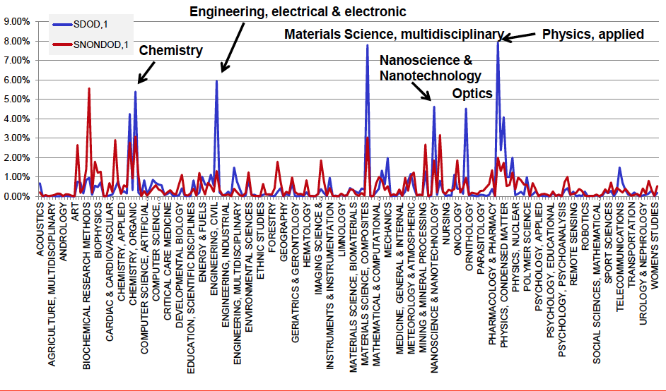
Selective Basic Research Portfolio

Slide 11
What is the DoD’s Mission?

Slide 12
DoD Basic Research Mission
Basic research probes the limits of today’s technologies and discovers new phenomena and know-how that ultimately lead to future technologies
Basic research funding attracts some of the most creative minds to fields of critical DoD interest
From: Defense Science Board Task Force Report on Basic Research (2012)

Slide 13
DoD Basic Research Mission
Basic research funding creates a knowledgeable workforce by training students in fields of critical DoD interest
Basic Research provides a broad perspective to prevent capability surprise by fostering a community of U.S. experts who are accessible to DoD, and who follow global progress in both relevant areas, as well as those that may not seem relevant – until they are.
From: Defense Science Board Task Force Report on Basic Research (2012)

Slide 14
What makes the DoD 6.1 Research Different?
Highly mission oriented
Time horizons to applications tend to be short
Program managers are given tremendous discretion

Slide 15
So… how do I get the $$$?

Slide 16
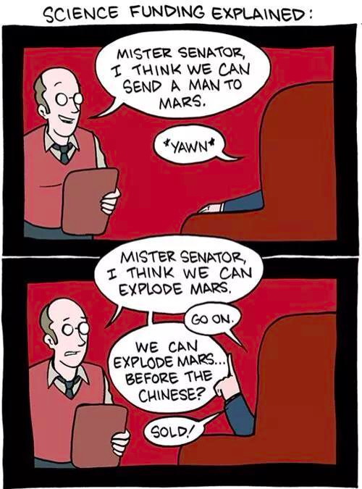

Slide 17
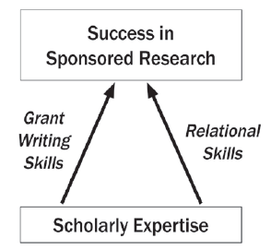
Skill Set for Success

Slide 18
Study the BAAs and DoD Lab Priorities
Explore the websites!
Find out what is going on in the defense laboratories … more on this later

Slide 19
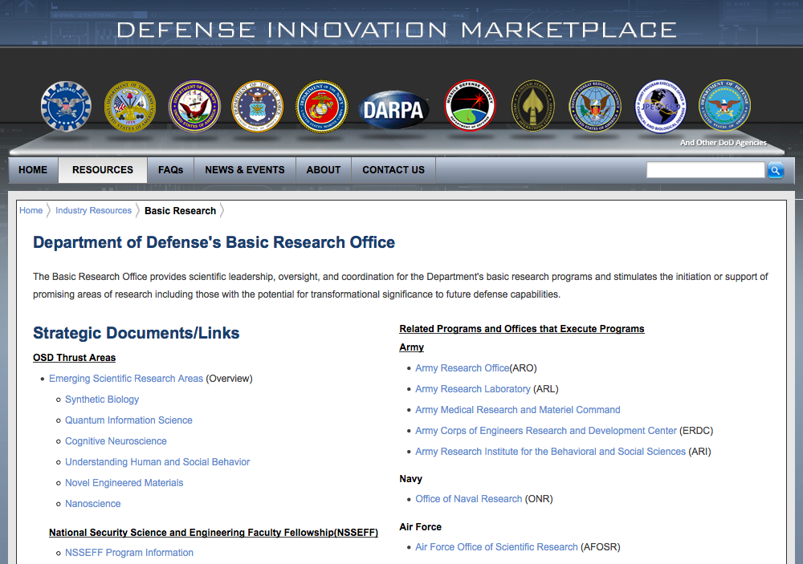
Where can I start?
http://www.defenseinnovationmarketplace.mil/basicscience.html
http://www.defenseinnovationmarketplace.mil/basicscience.html
http://www.defenseinnovationmarketplace.mil/basicscience.html

Slide 20

What’s in the BAA?

Slide 21
Can we talk? Seeing the rest of the iceberg
Published materials should be viewed as the “official line” but may not reflect underlying considerations that rarely find their way into print
Program priorities shift over time and published materials remain unchanged

Slide 22
Can we talk? Seeing the rest of the iceberg
A PMs candid, informal response is the BEST predictor of success even though no guarantee is expressed or implied
PMs can give valuable advice on budgets, program track, collaborations, and project structure
If it is not a good fit, the PM can let you know and recommend other PMs or agencies; Rejection can be a good thing

Slide 23

Finding the Right Fit

Slide 24
What NOT to do with PMs
Do NOT cold call… repeatedly
Do NOT SPAM multiple PMs
Focus on new ideas and concepts
Keep e-mails short and attach ~1 pg white paper
Do NOT send unsolicited proposals

Slide 25
A good Game Plan with PMs
Identify the grant program(s)
Write a brief pre-abstract summarizing the proposed project
  List: objectives, methods and expected outcomes
  Highlight the uniqueness and how the outcome will address important problems
Start with an e-mail; include the pre-abstract
Make the call/visit the PM
Follow up:
  Thank the PM
  Summarize Key Points
  Express a Desire to Review Proposals
Take advantage of professional meetings

Slide 26
How to Talk
Does my project fall within your current priorities?
What would you recommend to improve my chances for a favorable review?
Do you expect last year’s award amount to change this year?
What are some of the common reasons for proposal rejection?

Slide 27
BAA: ARO Examples
Program | Deadline | Amount/Time | Limitations
Single Investigator | Open | ~$120k/yr for 3-4 years | Few
Short Term Innovative Research | Open | $50k/9-months | No NCEs **No Indirect Costs**
Young Investigator | Open | $50k/year for 3-years | Citizen / Green Card < 5 years from Ph.D.
HBCU/MI | January | $200 k / year for 3-years | HBCU/MI/MSI eligible

Slide 28
Young Investigator / Early Career
Program | Deadline | Amount/Time | Limitations
ONR YIP | Early January | $170k/yr for 3-years | Citizen / green card < 5-years of tenure track appointment
AFOSR YIP | July/August | $120k/yr for 3-years | Citizen / green card Ph.D. < 5 years
DARPA YFA | January | $500k over 24 months | < 5-years of tenure track appointment
ARO YIP | Open | $50k/yr for 3-years | Citizen / green card Ph.D. < 5 years
DOD PECASE | Early June | $200k/yr for 5-years | Citizen / green card < 15 scholars from Army, Navy and AF Ph.D. < 5 years

Slide 29
Multidisciplinary University Research Initiatives (MURI)
Program | Deadline | Amount/Time | Limitations
MURI | February | $7.5 M / 5-years | <7 investigators
http://www.onr.navy.mil/Science-Technology/Directorates/office-research-discovery-invention/Sponsored-Research/University-Research-Initiatives/MURI.aspx

Slide 30
Defense University Research Instrumentation Program (DURIP)
Recommended to have:
  Existing DoD grant
  Collaborations with DoD laboratory
Focus on the new science that will be enabled
Remember “Sagan’s Theorem” – Extraordinary claims require extraordinary proof
Unless you can demonstrate very broad impact (e.g. benefit to multiple DoD grants), keep the funding requests small (< $150k) for your best chance of success
http://www.onr.navy.mil/Science-Technology/Directorates/office-research-discovery-invention/Sponsored-Research/University-Research-Initiatives/DURIP.aspx

Slide 31
Small Business Grants
Small Business Innovation Research (SBIR) and Small Business Technology Transfer (STTR)
Great opportunities for University spin-offs
STTRs require University involvement
Contact small businesses to let them know you can enhance their capabilities

Slide 32
HBCU/MSI Opportunities
These are typically set-aside DoD funds
UC – Riverside is may be eligible !
Check the BAA
Note HBCU/MSI Instrumentation Grant opportunities (Research and Education Programs / Equipment and Instrumentation
http://www.acq.osd.mil/rd/basic_research/program_info/hbcu.html

Slide 33
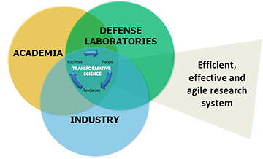
“Open Campus” Opportunities
Army: http://www.arl.army.mil/opencampus/
ONR: http://www.onr.navy.mil/Education-Outreach/Summer-Faculty-Research-Sabbatical.aspx
AFOSR: http://www.wpafb.af.mil/library/factsheets/factsheet.asp?id=9380

Slide 34
Why this is important:
Integrated into the laboratory environment
Will need a DoD PM/Researcher sponsor
Good interactions = higher funding possibility
Involving graduate students establishes possibilities for networking and employment

Slide 35
Special Considerations
DoD culture is very different than academic culture – make sure expectations are clear
  Does your PM want a “feelie”?
  Are there milestones or is the schedule more lax?
  Are there clearance/restriction issues?
  Are there procedures for publications/presentations?

Slide 36
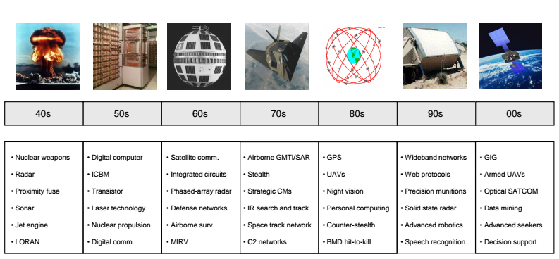
DoD Basic Research provides the Early Foundations of Progress

Slide 37
Summary
Find the right fit for your research
Efficiently communicate with PMs
Integrate with DoD Laboratories / Industries

Slide 38
My 411
Suveen Mathaudhu
  smathaudhu@engr.ucr.edu

