Slide 1

The BCOE Grants and Contracts Office
(329 & 333 Winston Chung Hall)
Huguette Albrecht, PhD, Assistant Director
October 5, 2020

Slide 2
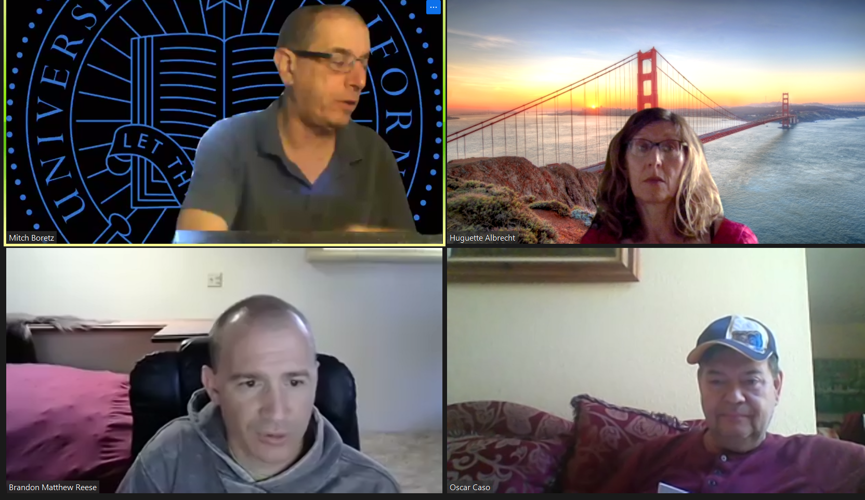
Your one-stop shop for contracts and grants
We do everything to help on your proposals (short of miracles)
The team
Mitch Boretz
mitch@engr.ucr.edu
Huguette Albrecht
halbrecht@engr.ucr.edu
Brandon Reese
breese@engr.ucr.edu
Oscar Caso
oscar@engr.ucr.edu

Slide 3
Examples of how we help on proposals
Advertise funding opportunities relevant to BCOE faculty
(Kathy Eiler, Director of Federal Relations)
Provide advice on building a funding portfolio
Discuss a potential submission with you
Help with preparing a proposal including:
Providing a proposal and/or project description outline and templates
Developing the budget and budget justification
Collecting and preparing supplementary documents as needed
Reviewing your proposal components for compliance
Technical editing
Submission to RED
We look forward to helping you get lots of money to support your research
and your career!

