Slide 1
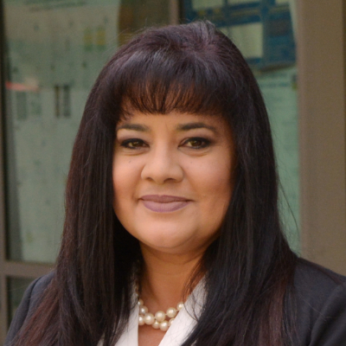
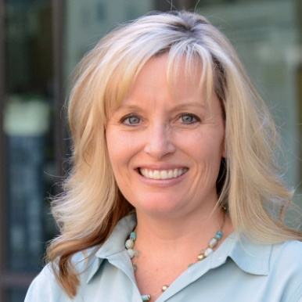
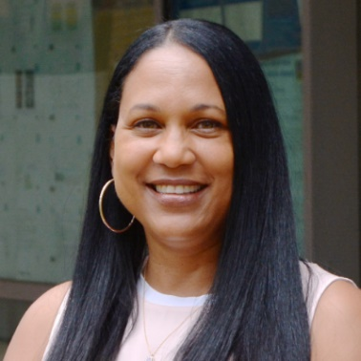
CPSU (Central Personnel Service Unit)
Cecilia Gonzalez
Academic Personnel/Human Resources Director
Tiffany Lindsey
Academic Personnel/ Human Resources Analyst
Bioengineering (BIEN)
Chemical & Environmental Engineering (CEE)
Electrical & Computer Engineering (ECE)
Angelique Jones
Academic Personnel/ Human Resources Analyst
Computer Science Engineering (CSE)
Mechanical Engineering (ME)
Timing of Advancement file, eFile, Leaves, Academic Personnel Policy interpretation, Stop the Clocks

Slide 2
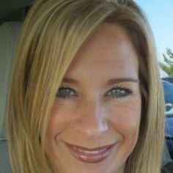
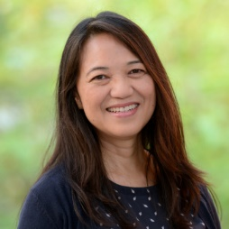
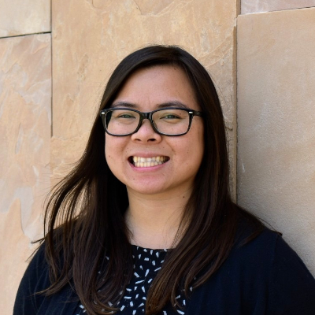
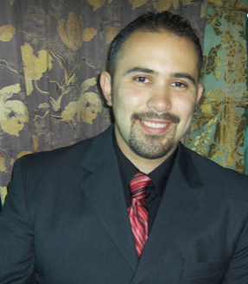
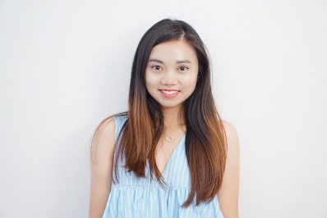
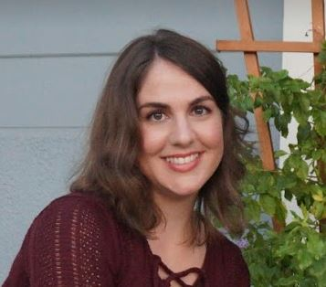
POSSC (Payroll Online Shared Service Center)
Janna LeBlanc
AP/HR Assistant Director
POSSC Operations Manager
Angie Elliott
Payroll Analyst
School of Business
School of Public Policy
School of Education
Christine Kitajima
Payroll Analyst
CEE
BIEN
WCGEC
Matthew Barajas
Payroll Analyst
CSE
CEN
Rebecca Wu
Payroll Analyst
ME
MSE/MSOL
CE-Cert
Dean’s Office
Emily Kirkland
Payroll Analyst
ECE
POEM/UC Light/CRIS/CNSE
Grad Division
Library
Questions about paycheck, issues with UCPath Portal, Resolutions with UCPath office, Leave Administration

